Slide 1
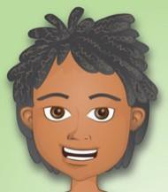
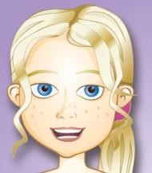
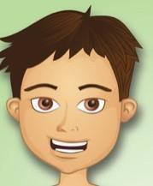
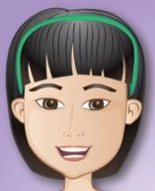

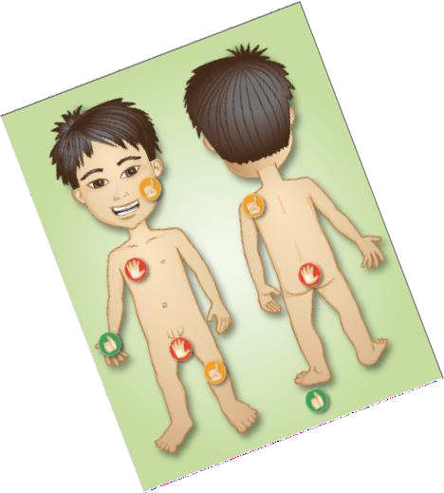
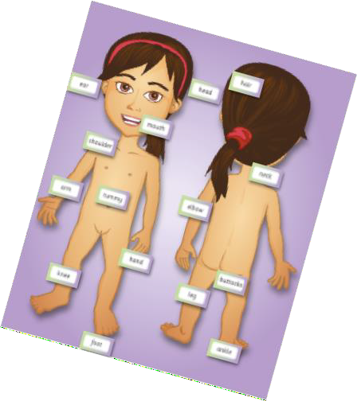



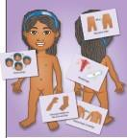
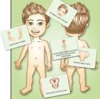
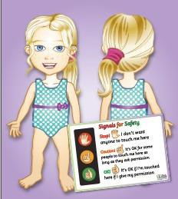





Relationships and Sexuality Education
In Progression step 1 age 3-7 Children will:
Understand diversity of families and relationships and why these are important.
Use accurate terminology for all body parts.
Be aware of how human bodies change as they grow.
Understand the importance of personal self-care and hygiene.
Recognise that everyone’s body is unique and special to them.
In Progression step 2/3 age 7-11
Children will:
Be aware of the characteristics of different families and friendships and their diversity.
Understand the importance of sex and gender equality.
Understand different kinds of harmful or abusive behaviour and the role technology can play.
Develop skills to build consensual relationships and know how to safely respond and report harmful
behaviours and relationships offline and online.
Understand how to keep safe online.
INFORMATION FOR PARENTS/CARERS
Relationships and Sexuality Education (RSE) is mandatory within the Curriculum for Wales 2022.
Our comprehensive whole school programme is based on the requirements of the RSE Code 2021, Welsh Government
The school acknowledges that parents/carers are essential to the success of our RSE programme. This leaflet outlines some of the broad mandatory content that will be taught within our whole school RSE programme.
Understand how children and young people experience changes during puberty.
Know how to manage personal self-care and
hygiene, including the importance of menstrual well-being.
Understand how reproductive organs develop in the human body.
Understanding fertility and the processes of reproduction..
Recognise the process of pregnancy and birth.
Evidence emphasises that children and young people who have received effective early RSE are more likely to keep themselves safe and make informed choices in respect of their health and wellbeing.
Parent/carers are welcome to make arrangements to visit school to view and discuss the materials and resources used in RSE lessons.
Understand everyone’s right to privacy, personal boundaries and which parts of the body are private.
Be able to communicate if someone is touching them in a way that makes them feel uncomfortable.
Be able to recognise positive and harmful behaviours, including bullying.
in association with
© Teach Health 4 Kids 2022. All Rights Reserved

