Slide 1
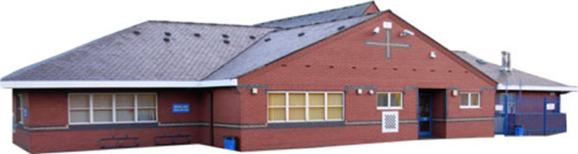
Ysgol Rhostyllen
We believe that the best gift we can give our children apart from love is education.

Slide 2

Our Vision
At Ysgol Rhostyllen we recognise that all children need love, care, time and understanding. Their primary education is a vital part of a growing awareness of the wider world, for which they need to gain knowledge and skills essential to life. It is of the utmost importance that children are happy at school if they are to reach their potential.
Our aims at Ysgol Rhostyllen are:
To maintain a happy, caring environment with a secure and welcoming atmosphere which gives children the confidence to become independent learners.
To promote respect for all, regardless of differing religious beliefs and ways of life and develop a culture which is opposed to discrimination relating to socio-economic background, creed, ethnic origin, gender or disability.
To provide learning environments where children can enjoy success through well planned activities and which caters for individual needs.
To plan a broad, balanced and relevant curriculum for each child’s physical, intellectual, emotional, social and moral needs.
To work in close partnership with the child’s home and family to promote a positive educational experience and which helps children to interact successfully with their peer group, family and community.
To actively encourage lifelong learning, promote high standards and encourage all children to achieve their potential.
What is ‘Curriculum’ in Ysgol Rhostyllen ?
A school curriculum is everything a learner experiences in school. When designing Ysgol Rhostyllen’s curriculum we have the needs of our learners at the forefront of all decisions. We carefully consider What we teach, How we teach it and also Why we teach it. We relate this process to our context within our local community, both as a village school and a school situated very close to the city of Wrexham.

Slide 3
Our Values | Our Behaviours
Happiness | To maintain a happy, nurturing environment with a secure and welcoming atmosphere which gives children the confidence to become independent learners and citizens.
Respect | To promote respect for all, regardless of differing beliefs and ways of life and develop a culture which is opposed to discrimination relating to socio-economic background, creed, ethnic origin, gender or disability.
Inclusivity | To provide learning environments which promote independence, where individual children can enjoy success whilst achieving their own potential.
Community | To work in close partnership with the child’s home and family to promote a positive educational experience which helps children to interact successfully with their peer group, family and community/cynefin.
Wellbeing | To develop mental and emotional wellbeing by promoting confidence, resilience and empathy.
Resilience | To support each other as learners and staff to be confident and proud of ourselves, to embrace challenge and persevere to achieve our goals.
Aspiration | To actively encourage lifelong learning by promoting high standards, whilst inspiring children to embark upon a journey of continuous development and learning.

Slide 4




The Curriculum for Wales 4 purposes are the heart and core of Ysgol Rhostyllen’s curriculum
They underpin all aspects of our curriculum design, planning and teaching. Our vision and values as a school support the 4 purposes and we summarise below what they mean for us. Our learning experiences and teaching methods will always aim for this, with the targeted ‘purpose’ of specfic lessons to always be shared with our children across the school.
Ambitious, capable learners ... who are ready to learn throughout their lives, and who: | Enterprising, creative contributors ... who willing to play a full part in life and work and who: | Ethical, informed citizens ... who are ready to be citizens of Wales and the world, and who: | Healthy, confident individuals ... willing to lead fulfilling lives as valued members of society, and who develop:
set high standards for themselves enjoy challenge and solve problems develop knowledge and skills and apply them in different contexts are able to discuss their learning confidently Are able to communicate effectively in English and Welsh use mathematics and numeracy and digital technologies effectively | think creatively apply their knowledge and skills to create, adapt and to solve problems identify and grasp opportunities Are confident to take risks lead and work together in teams express ideas and emotions in different ways use their energy and skills for the benefit of others | make judgments and discuss issues based on their knowledge and values understand and exercise their responsibilities human rights understand and consider the impact of their actions know about their culture and community, know about society and the world in the present and past respect the needs and rights of others, as a member of a diverse society see that they have a role to play to ensure the planet's sustainability | physical and mental health and safety, relationships based on respect and trust personal values skills and independence to deal with everyday life the ability to face and overcome challenges

Slide 5
Planning
When planning at Ysgol Rhostyllen, we plan for a main focus AoLE each half term with the other five AoLE’s taught in a cross-curricular context. We involve pupils in our planning process to draw on their areas of interest and ideas to create topic webs. *Pupils developing as ‘planners’ involved in curriculum development alongside class teachers/AoLE leaders. *Decisions regarding learning routes (topics, teaching approaches) are collaborative. Teachers plan activities weekly, with non-negotiable aspects incorporated into their planning.
We also plan to ensure that our provision and teaching develops the integral skills below which are essential for our learners to achieve the 4 purposes.
Creativity and innovation | Inquire, explore, be curious, create and share ideas Link experiences, knowledge and skills
Critical thinking and problem solving | Question and evaluate information and situations Identify problems and suggest different solutions Make decisions objectively
Personal Effectiveness | Develop emotional intelligence, confidence and independence Evaluate and discuss their current learning and next steps appreciate the value of and celebrate mistakes discuss and consider their views and values, and their ethical, social, cultural implications
Planning and organisation | Set goals for their learning and discuss and reflect on their progress
The concepts and mandatory elements
The school will carefully consider the mandatory elements of the curriculum when planning. The school's policies for these areas detail our intentions.
Cross-curricular development of literacy, numeracy and digital competence skills
Religion, values and ethics Education,
Relationships and Sexuality,
Welsh
English is the day to day language of our school with some Welsh used as a language of communication with pupils on an incidental basis. As a school within Wales, we pride ourselves on celebrating our country’s language and culture. We endeavour to promote the Welsh language so that it can survive as a living tongue as our pupils acquire second language skills.
Statutory Elements
The school has considered the following statutory elements within the Curriculum for Wales Framework when designing our curriculum;
Careers & work related experiences
Well-being of Future Generations (Wales) Act 2015
United Nations Convention on the Rights of the Child (UNCRC)
United Nations Convention on the Rights of Persons with Disabilities (UNCRPD)
Additional Learning Needs and Education Tribunal (Wales) Act 2018

Slide 6
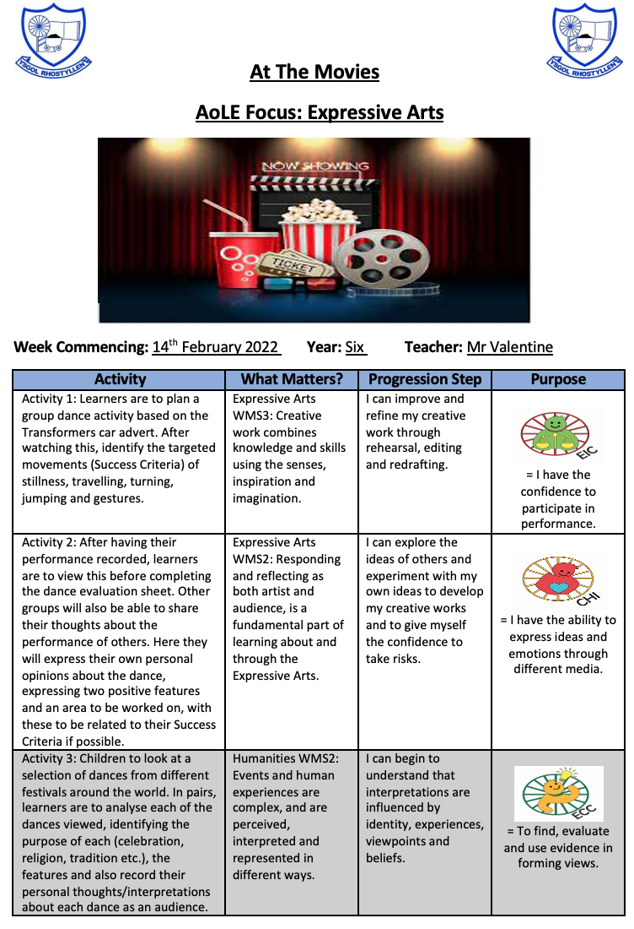
Planning
A combination of approaches to curriculum design is used in this school according to learner age and learning context. Elements of planning for direct teaching disciplinary and multidisciplinary approaches will be used learn and practice specific skills E.g. maths skills, phonics
Interdisciplinary and integrated approaches are used to practice and apply skills hem in different cross curricular context. E.g. draw elements of Maths, Language, Digital Competence and Humanities when researching and writing a report comparing weather in Wales and Italy.
We aim to plan and develop exciting learning experiences which are relevant to our children with a clear purpose of developing their skills in a variety of contexts.
Cross-Curricular Skills
Literacy, Numeracy and Digital Competence is a statutory responsibility across all Areas of Learning and Experience. We fully realise the importance of ensuring our learners digital competence in order to prepare them for future life and work.
We therefore pay close attention to this when planning learning experiences and when planning for learners’ progress. We will plan plenty of opportunities for them to acquire, practice and apply these important skills and to embed them.
Enjoying learning
The most important thing for us in planning is to ensure that learners enjoy in their learning and have fun. So, we work hard to ensure that:
The learning experiences are interesting and stimulating.
That our teaching and working relationships with our learners inspire enthusiasm and enjoyment for all.
We involve learners within our planning process to create further interest and an ownership over their learning experiences.
Health and Wellbeing
Learners’ involvement in planning contributes to a sense of wellbeing. We carefully consider how mental and physical wellbeing can be promoted both holistically across the whole school, and also during individual learning experiences in and out of the classroom.
Collaboration
Our teachers, AoLE leaders and learners work together to decide upon learning experiences in a collective, shared process.

Slide 7
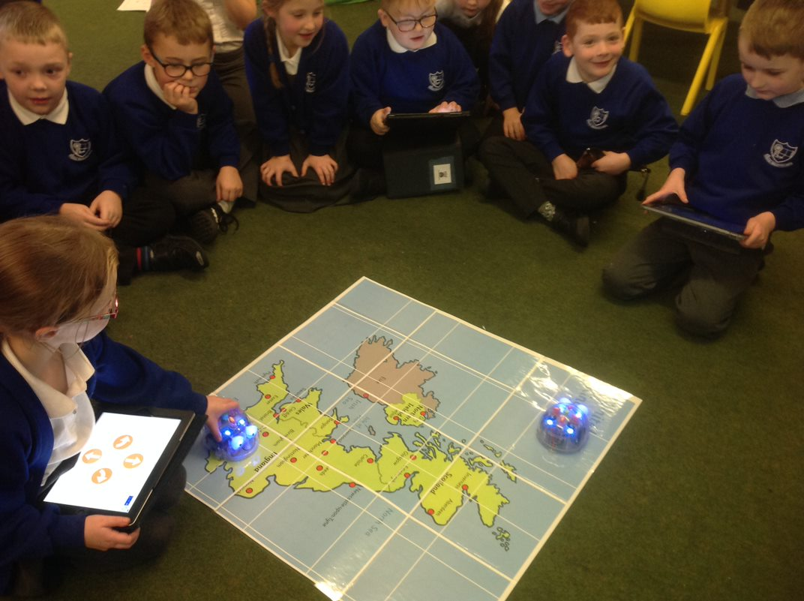
Teaching
Excellent teaching is essential if we are to realise the 4 purposes, our vision as a school and the requirements of the Curriculum Framework. Ensuring a high- quality learning environment is vitally important to us at Ysgol Rhostyllen, for both learners and practitioners. Consistency of ethos in every class across the school is of paramount importance for us to ensure a safe and inspiring learning environment so that our learners can take risks, make mistakes confidently and work in an atmosphere of mutual respect and appreciation of everyone’s efforts.
The central focus of the curriculum..........whilst also developing the essential skills of Literacy, Numeracy and Digital Competence. This will be done with a balance of both subject specfic and thematic teaching approaches. Pupils will be encouraged to apply their skills across the curriculum.
We constantly reflect upon, share and develop our teaching practices, based on our understanding of the 12 pedagogical principles set out in the Curriculum Framework and the practices we find to be successful in our school.
The 12 Pedagogical Principles
1. Focus on achieving the 4 purposes | 2. Challenge learners and emphasise the importance of continuous effort. Convey high, achievable expectations | 3. Use a range of teaching methods | 4. Develop problem solving skills, creative skills and the ability to think creatively.
5. Building on prior knowledge and experience. Engage interest. | 6. Creating authentic contexts | 7. Implementing formative assessment principles | 8. Extend within and across the Areas of Learning
9. Reinforcing and practicing cross-curricular skills - literacy, numeracy and digital competence | 10.Develop learners to take increased responsibility for their own learning and to develop as independent learners. | 11.Promote social and emotional development and positive relationships | 12.Promote collaboration
As we evolve the Curriculum for Wales in Ysgol Rhostyllen, experimenting and innovating confidently as practitioners is very important to us and we shall collaborate closely within the school and across the cluster to ensure the highest possible quality of learning experiences and teaching for our learners.
The school is a learning organization. This means that we constantly research and learn about effective teaching and value professional learning and research-based practice to develop and improve our teaching skills.

Slide 8
The Curriculum for Wales gives us the freedom to design our own content based on:
• 6 Areas of Learning and Experience and their What Matters Statements
• Cross Curricular Skills Development
• 5 Cross-Cutting Themes
The 6 Areas of Learning and Experience
The Expressive Arts | Health and Wellbeing |  | Humanities |  | Mathematics and Numeracy |  | Languages, Literacy and Communication |  | Science and technology
Disciplines developed in this school : Art, Music, Dance Drama Film and Digital Media | Disciplines developed in this school : Physical Health and development, mental health, emotional and social wellbeing |  | Disciplines developed in this school : Geography, History, Religion , Values and Ethics, Business Studies, Social Studies, Economics, Philosophy |  | Includes 5 interdisciplinary competences: 1.Conceptual Understanding 2.Communication using symbols 3.Fluency 4.Logical reasoning 5.Strategic competence |  | Disciplines developed in this school : Welsh,English, International Languages, Literature |  | Disciplines developed in this school : Biology, Chemistry, Computer Science, Design and Technology, Physics
Cross Curricular Skills We will plan for the development of the following cross-curricular skills within and across the Areas of Learning and Experience using the revised national frameworks
Literacy |  |  | Numeracy |  |  |  | Digital Competence
Cross-cutting themes We shall include and extend the themes below across the curriculum
Relationships and sexuality education |  | Human Rights education and the united Nations Convention on the Rights of the Child ( UNCRC |  | Diversity |  | Careers and work-related experience |  | Local,National and International Context
The What Matters Statements for each Area will be the basis of our planning for progression, depth and breadth of skills and knowledge and for learner progress.

Slide 9
The What Matters Statements for all six Areas of Learning Experiences
Expressive Arts | Health and Well-Being | Humanities | Language, Literacy and Communication | Mathematics and Numeracy | Science and Technology
WMS1 – Exploration through and of the Expressive Arts deepens our artistic knowledge and contributes to our understanding of identities, cultures and societies. | WMS1 – Developing physical health and well-being has lifelong benefits. | WMS1 – Enquiry, exploration and investigation inspire curiosity about the world, its past, present and future. | WMS1 – Languages connect us. | WMS1 – The number system is used to represent and compare relationships between numbers and quantities. | WMS1 – Being curious and searching for answers is essential to understanding and predicting phenomena.
WMS2 – Responding and reflecting both as artist and audience, is a fundamental part of learning about and through the Expressive Arts. | WMS2 – How we process and respond to our experiences affects our mental health and emotional well-being. | WMS2 – Events and human experiences are complex, and are perceived, interpreted and represented in different ways. | WMS2 – Understanding languages is key to understanding the world around us. | WMS2 – Algebra uses symbol systems to express the structure of mathematical relationships. | WMS2 – Design thinking and engineering offer technical and creative ways to meet society’s needs and wants.
WMS3 – Creative work combines knowledge and skills using the senses, inspiration and imagination. | WMS3 – Our decision-making impacts on the quality of our lives and the lives of others. | WMS3 – Our natural world is diverse and dynamic, influenced by processes and human actions. | WMS3 – Expressing ourselves through languages is key to communication. | WMS3 – Geometry focuses on relationships involving shape, space and position, and measurement focuses on quantifying phenomena in the physical world. | WMS3 – The world around us is full of living things which depend on each other for survival.
 | WMS4 – How we engage with social influences shapes who we are and affects our health and well-being. | WMS4 – Human societies are complex and diverse, and shaped by human actions and beliefs. | WMS4 – Literature fires imagination and inspires creativity. | WMS4 – Statistics represent data, probability models chance, and both support informed inferences and decisions. | WMS4 – Matter and the way it behaves defines our universe and shapes our lives.
 | WMS5 – Healthy relationships are fundamental to our well-being. | WMS5 – Informed, self-aware citizens engage with the challenges and opportunities that face humanity, and are able to take considered and ethical action. |  |  | WMS5 – Forces and energy provide a foundation for understanding our universe.
 |  |  |  |  | WMS6 – Computation is the foundation for our digital world.

Slide 10

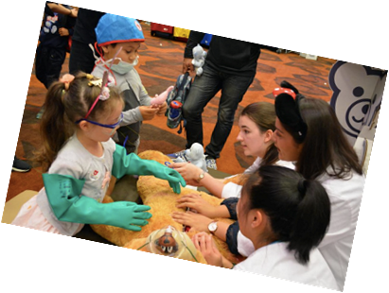
Assessment, Progression and Reporting
We use the Descriptions of Learning for each What Matters Statement to assess and plan for learners' progress.
These broadly correspond to expectations for ages 5, 8, 11, 14 and 16 and offer guidance on how learners should demonstrate progress within each Statement.
These are not used as a list of tick boxes, but as tools to consider when planning for our learners' progress.
In addition, there are Principles of Progression that underpin our planning for learners' progress across the fields over time.
Principles of Progression
Increasing breadth and depth of knowledge | Deepening understanding of the ideas and disciplines in the Areas | Refinement and growing sophistication in the use and application of skills | Making connections and transferring learning into new contexts | Increasing effectiveness
The Curriculum for Wales gives us the opportunity to ensure that learners' progress is the primary purpose of Assessment and not an accountability exercise.
As a school we will implement the following assessment arrangements:
Support individual learners on a daily basis based on their specific abilities, interests and needs.
Formative assessment of consistently high quality in the day-to-day classroom to provide learners and practitioners with a clear picture of attainment and next steps.
Identifying, capturing and reflecting on individual learner progress over time.
We support teacher assessment with National Numeracy and Literacy personalised assessments in Years 2-6. The literacy test has been designed to test the reading capabilities and the numeracy tests assess the children’s procedural maths and reasoning skills.
We assess and monitor each learner’s wellbeing through the use of PASS testing near the beginning of each school year.
We use Seesaw as a platform to record and share learner’s work during the school day.
ClassDojo is used as a platform to ensure regular and consistent communication with parents.
We continually assess individual progress through assessment of tasks in English and maths, and whole class attainment in each AoLE through whole school Assessment Portfolios.
Taith 360 will be utilised by all of our teachers as a tracking and assessment tool.
Analysis of completed work to gain an understanding of group progress in order to reflect on practice and inform future planning.
Practitioners are given specific and regular periods to discuss the progress and needs of learners and specific groups of learners through professional dialogue in order to plan for further progress. Such discussions will also facilitate any transfer and transition between classes and schools.
Regular discussions are held with learners and their parents/carers to discuss progress involving external agencies when necessary.

Slide 11
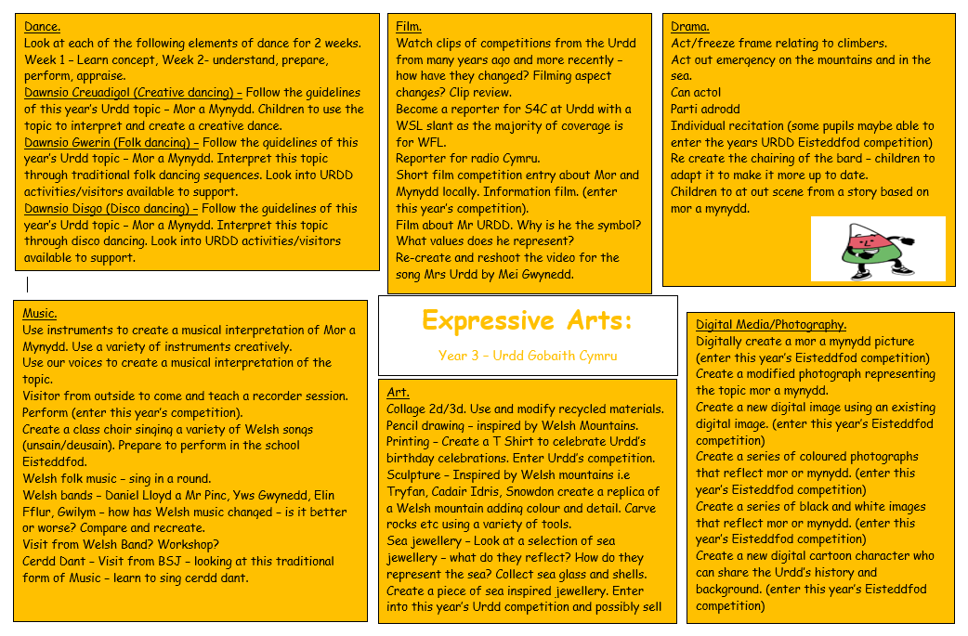
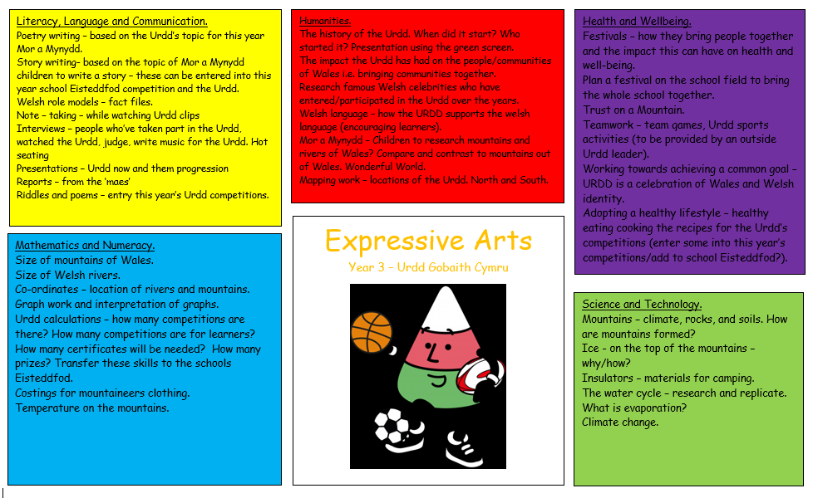
Example overview of the curriculum design elements in action
Most of the learning experiences at Ysgol Rhostyllen will be based upon a topic within a specific AoLE. For each AoLE, class teachers work closely with their class to decide topics and create topic webs to build upon the interests and knowledge of the children, with the aim of creating a range of ideas for learning experiences to take place across the half term. Below is an example of Year 3’s Expressive Arts topic ‘Urdd Gobaith Cymru’ and the two topic webs centred around this theme. On the left is the Expressive Arts topic web for the which is split into the different strands of the Expressive Arts AoLE, with these learning experiences taking place as part of the Expressive Arts focus for this half term. On the right is the cross-curricular topic web relating to this topic, with lesson ideas relating to the other five AoLE’s all detailed with these experiences to be delivered in a cross-curricular approach. It aims to address several aspects of each of the 4 purposes. It also provides opportunities to develop the cross-curricular skills, Literacy, Numeracy and Digital Competence within and across the 6 Areas of Learning and Experience.

